Slide 1
IoT Based Smart Greenhouse Management System
Manesh Nimsara Samararathne

Slide 2
Introduction to the System
The system is used to monitor the climate and tank level details of greenhouses and control the climate conditions in a automatable manner.
The system basically consists with a hardware system and a software system.
A web application is designed as the software system.
The hardware system consists with the sensors to monitor the soil moisture of greenhouse plants, lux level inside the greenhouse, temperature and humidity level inside the greenhouse, tank level of greenhouse and actuators such as fan motors, water pump motors and lights. The hardware system is power up using external power supplies

Slide 3
Introduction to the System
The web-based application is designed to monitor and analyze the greenhouse
Climate Conditions and tank level. In-built Communication platform is designed in the web application to help the greenhouse owners to solve the problems of greenhouse owners in a efficient way.

Slide 4
Overview of the hardware system
The Implementation of Internet Of Things Technology .
“Arduino” - electronic platform.
Sensors and actuators used and functionalities of them.
Electronic Modules and power supplies used and functionalities of them.
Processes of hardware sub systems.

Slide 5
Functional Requirements of the system

Slide 6
Non-functional Requirements of the system

Slide 7
Aims of the project

Slide 8
Scope of the project

Slide 9
Internet Of Things
The Internet of things (IoT) is a system of interrelated computing devices, mechanical and digital machines provided with unique identifiers (UIDs) and the ability to transfer data over a network without requiring human-to-human or human-to-computer interaction. (WIKIPEDIA, 2020)
WIKIPEDIA (2020) “Internet of things” Available at:
https://en.wikipedia.org/wiki/Internet_of_things
Accessed at: 19th May 2020.

Slide 10
Application of the IoT concept to the system.

Slide 11
“Arduino” - electronic platform
Arduino is an open-source electronics platform based on easy-to-use hardware and software. Arduino boards are able to read inputs - light on a sensor, a finger on a button, or a Twitter message - and turn it into an output - activating a motor, turning on an LED, publishing something online. You can tell your board what to do by sending a set of instructions to the microcontroller on the board. To do so you use the Arduino programming language (based on Wiring), and the Arduino Software (IDE), based on Processing. (ARDUINO,2020)
ARDUINO (2020) “What is Arduino?” available at:
https://www.arduino.cc/en/guide/introduction
Accessed at: 19th May 2020.

Slide 12
Sensors and actuators used in the system
Sensors | Functionalities
DHT 11 Temperature and Humidity sensor | Track the temperature and humidity level inside the greenhouse
F-28 Soil Moisture sensor | Track the soil moisture level of the plants inside the greenhouse
LDR Sensor | Track the LUX level inside the greenhouse
Ultrasonic Sensor | Track the water level of the greenhouse water tank

Slide 13
Sensors and actuators used in the system
Actuators | Functionality
Two DC Brushless fans | Stabilize the temperature level inside the greenhouse.
16*2 LCD Display
LED lights | Provide artificial lighting to the plant in low light level conditions.
Two Water pumps | Pump water from the resource water supply to the greenhouse water tank And from greenhouse water tank to plants.

Slide 14
Electronic Modules and power supplies in the system
Electronic Module / Power supply | functionality
Four Channel Relay module
12 AC to DC power supply
I2C Convertor

Slide 15
Sub hardware system in the main system
Automated plant watering system.
Automated Lighting system.
Automated temperature controlling system.
Automated tank water filling system.

Slide 16
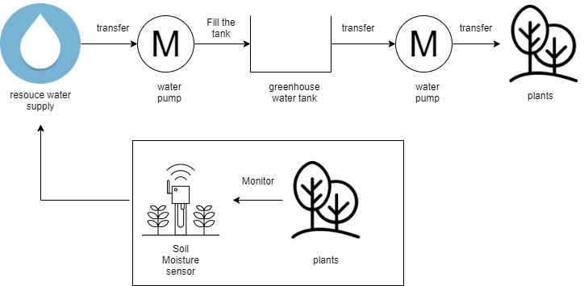
Automated plant watering system

Slide 17
Automated plant watering system

Slide 18
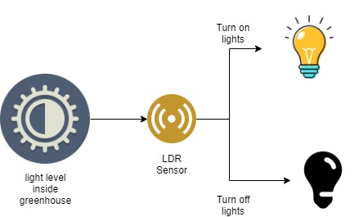
Automated Lighting system

Slide 19
Automated Lighting system

Slide 20
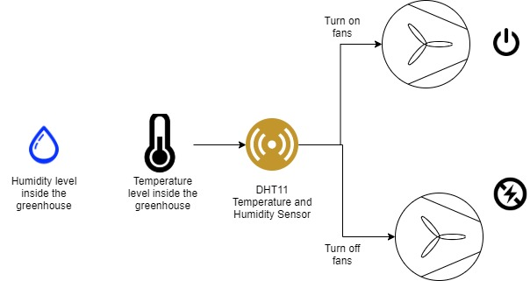
Automated temperature controlling system

Slide 21
Automated temperature controlling system

Slide 22
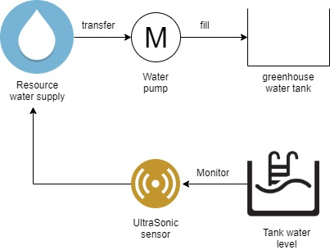
Automated tank water filling system

Slide 23
Automated tank water filling system

Slide 24
Overview of the software system
Angular framework usage to the web application design.
MySQL web service usage to the web application design.
Sections of the web application
    System Registration
    System Login
    Chat platform
    Agro-Instructor dashboard
    Greenhouse Owner dashboard
      Sensor data dashboard
      Add greenhouse dashboard
      Analyzed data dashboard

Slide 25
Angular framework

Slide 26
Application of the Angular framework to design the web application

Slide 27
MySQL Database service

Slide 28
Application of the MySQL Database service to design the web application

